Slide 1
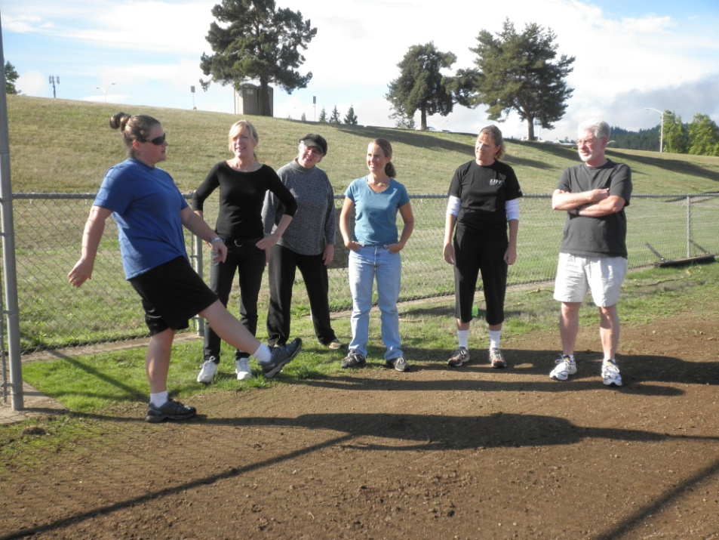
NEW FACULTY WELCOME
What does wellness mean to you?
What is your vision for a culture of Wellness at LCC?

Slide 2
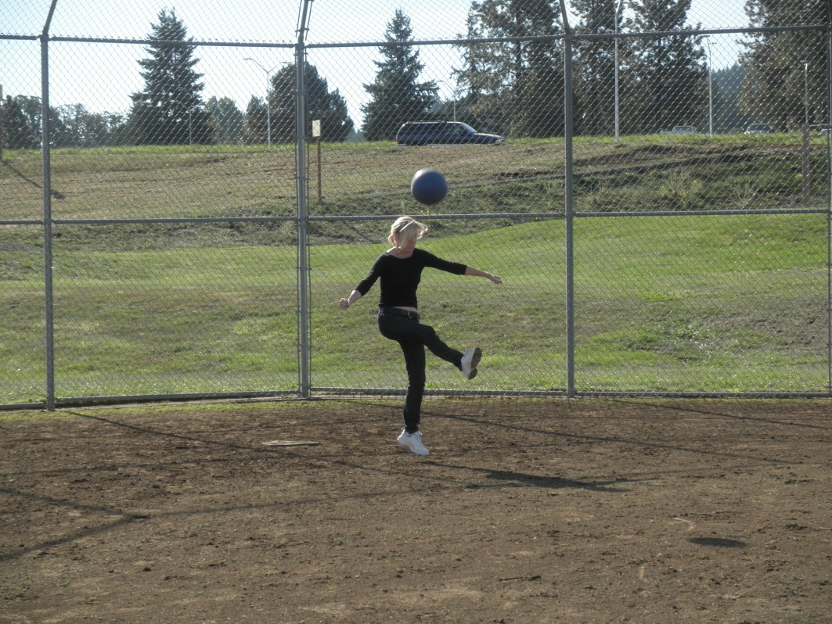
WELLNESS AT WORK
LCC supporting wellness and how you can support wellness
Relationships
Positivity
Notes:
Roxanne Young at kickball, Inservice ‘10

Slide 3
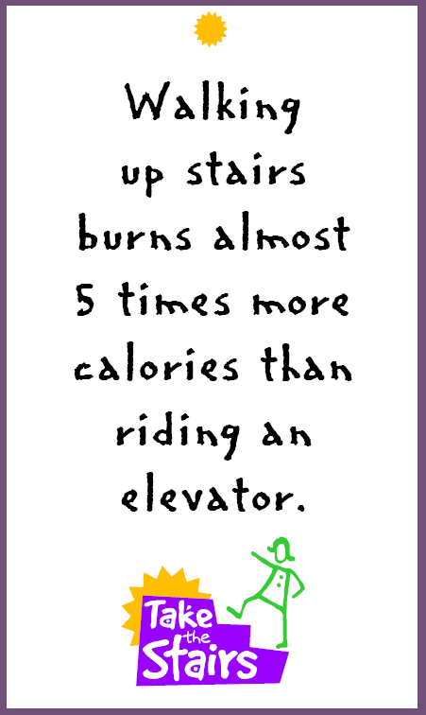
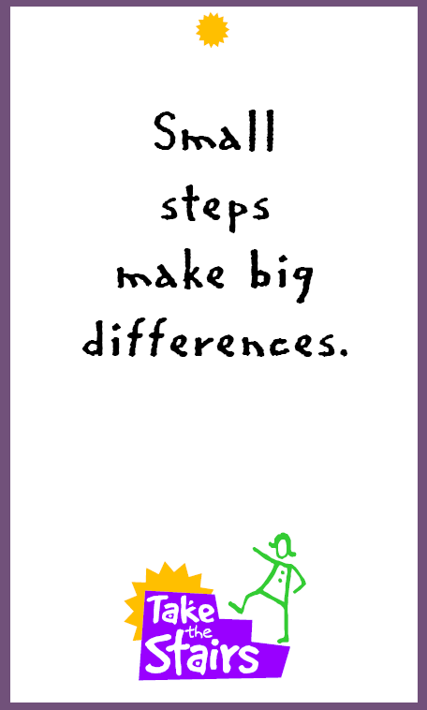
LCC Wellness
Making it easier for people to make the healthy choice
E.g. Make the stairs more inviting:

Slide 4
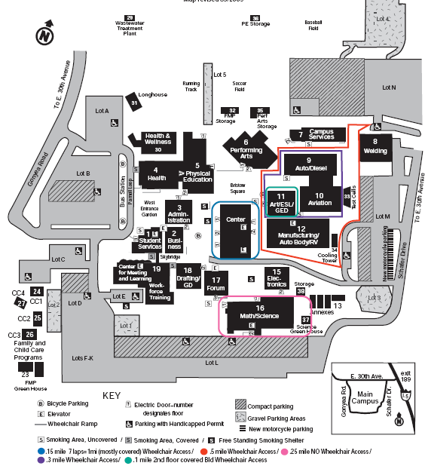

Slide 5

Tobacco Free Work place

Slide 6

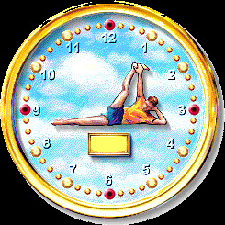


Slide 7
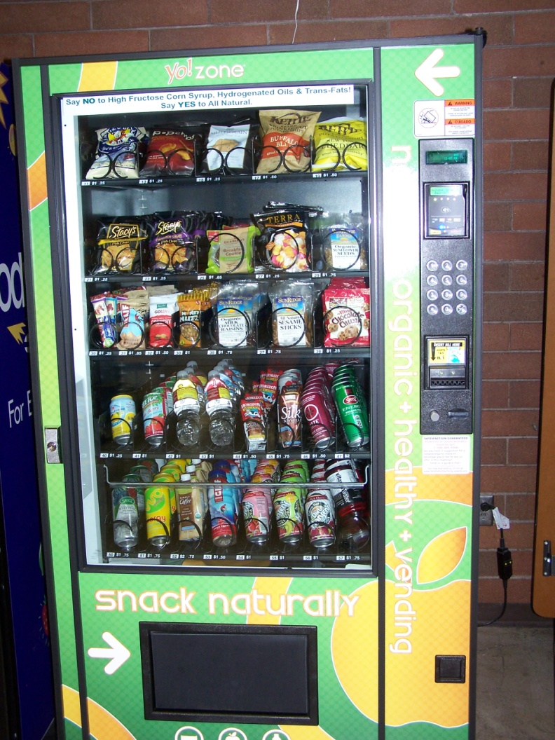
Healthier Vending Machines

Slide 8
Work Station Ergonomics
text
Stay somewhere between the lines

Slide 9
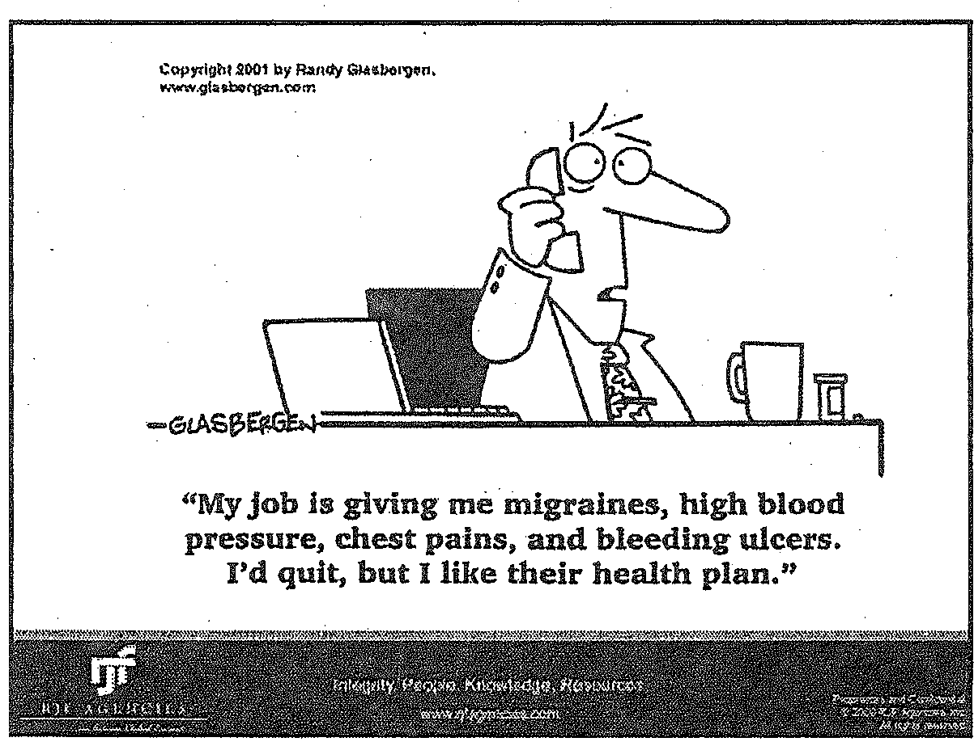
Let’s Make our Work Place Healthy

Slide 10
How can you encourage wellness at LCC?
Healthy food options at meetings
Walking breaks/meetings
Standing/stretching at your desk
Use fitness facilities; shower/locker rooms
Encourage polices for healthy foods at meetings
Take the stairs
Take wellness/PE classes
Use your personal trainer/wellness Coach (Wendy and Layne)
Check out myLane menu items for healthy eating
Use the Health Clinic

Slide 11
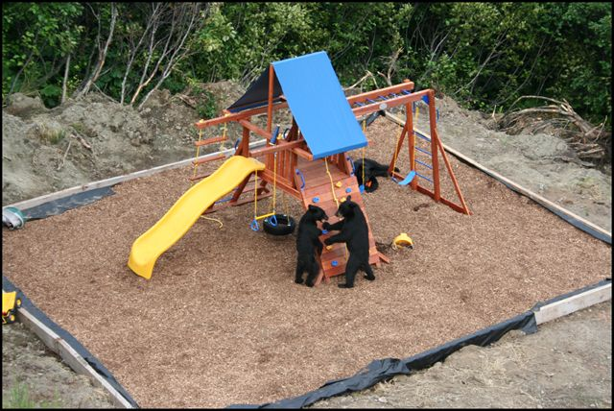
If you build it they will come

Slide 12
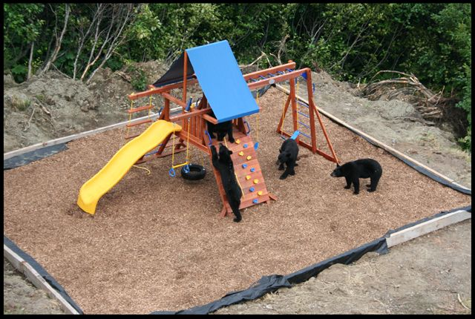
And come back for more

Slide 13
The Science of Sedentary Behavior
News Flash: Too much sitting is hazardous to your health!
Sedentary activities: working at a desk or on a computer, driving, watching TV, eating a meal
You can be “active”, but also highly sedentary
1950’s research: men in physically active jobs vs. inactive jobs

Slide 14

The Science of Sedentary Behavior
Sitting vs. standing:
Higher insulin concentrations, glucose, lipoproteins, tryglycerides, weight…. when sitting
Compare the same amount of sedentary time in two groups, but one group breaks up their time seated with standing breaks…

Slide 15
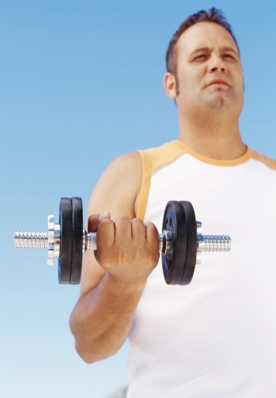


Plausible Waking-Day Metabolic Profile of an “Active Couch Potato”
Wake-up at 7:00 a.m.
Do structured workout – 60 minutes
Eat breakfast – 30 minutes
Drive to work – 45 minutes
Work at computer – 4 hours

Slide 16



Plausible Waking-Day Metabolic Profile of an “Active Couch Potato”
Eat lunch – 45 minutes
Work at computer – 4 hours
Drive home – 45 minutes
Eat dinner – 45 minutes
Watch TV/Read 3.5 hours
Go to sleep at 11:00 p.m.

Slide 17


How can you implement a plan to reduce sedentary behavior?
“SIT FOR 60, STAND FOR 3”
Go to the farthest bathroom in your building
Stand or walk around the room when on the phone
Take a 5-minute walk break
Walk to a colleague’s office instead of emailing
Take stretch breaks

Slide 18
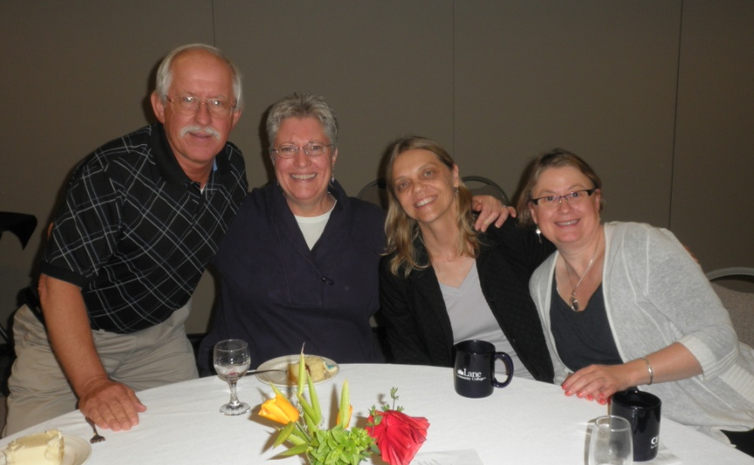
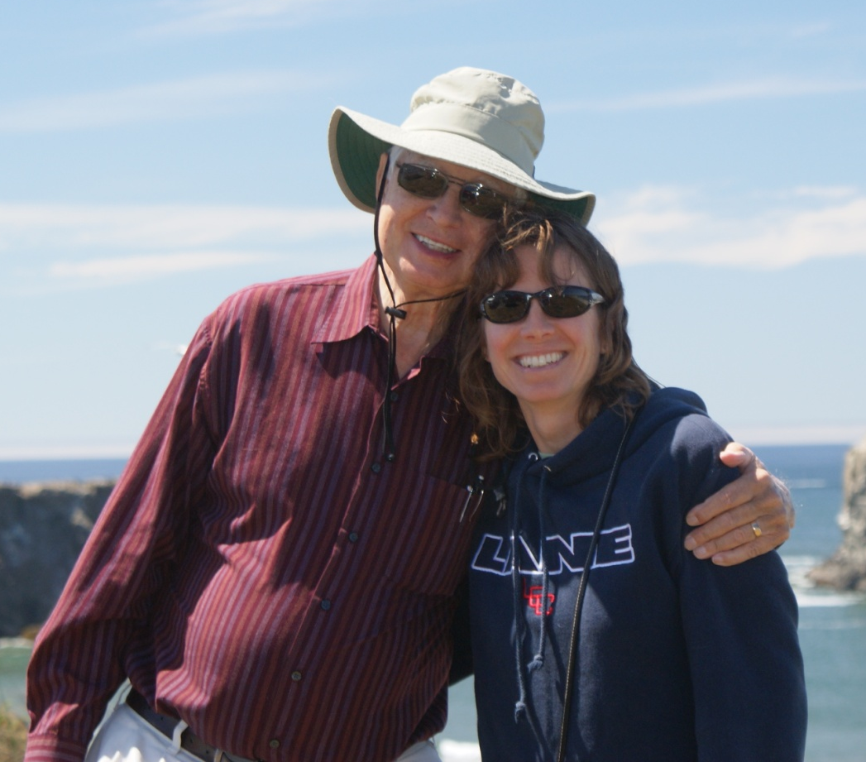

The Healing Power of Cultivating Relationships
Traditional Cardiovascular Risk Factors: High blood lipids, tobacco use, DM, Htn, Physical Inactivity, High alcohol intake, Family history
New Cardiovascular Risk Factors: Isolation/Loneliness, Stress and/or Hostility (only tobacco is a greater risk for CV disease than psychological factors) – Dr. Dean Ornish

Slide 19
Love & Intimacy at work
Love: Respecting & accepting others for who they are and who they want to become; Promoting emotional/spiritual growth of others;
Using good communication skills
Seeing each other as whole and complete, vs. having the “I can fix them” attitude
Intimacy: “Into-me-see”; it’s our greatest need and greatest fear; it’s self-revelation and vulnerability; accepting responsibility for our feelings

Slide 20

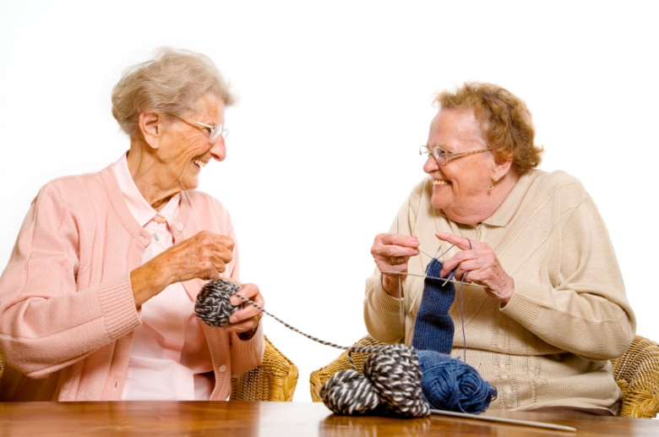
Dr. Ornish:
“I am not aware of any other factor in medicine - not diet, not smoking, not exercise, not stress, not genetics, not drugs, not surgery – that has a greater impact on our quality of life, incidence of disease and premature death from all causes than love and intimacy. At all ages and stages of life, there is a strong connection between our health and our human need for connection with others.”

Slide 21


Some Major Research Findings
People who are lonely, depressed or isolated are 3-5 x’s more likely to die prematurely.
Yale Study of 119 men and 40 women – examined coronary angiograms and compared results with degree of love felt…
Meta-analysis of 148 studies showed…

Slide 22


How can we Build Relationships?
Learn to communicate your feelings vs. thoughts
Spend more time with friends/family
Join or start groups with similar interests
Common shared experiences build trust create safety/promotes self-disclosure, understanding, empathy connects us

Slide 23
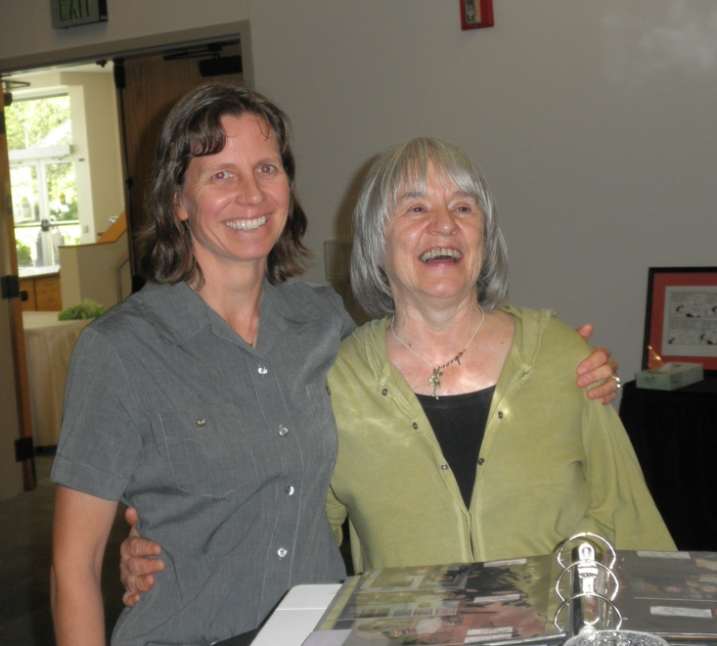
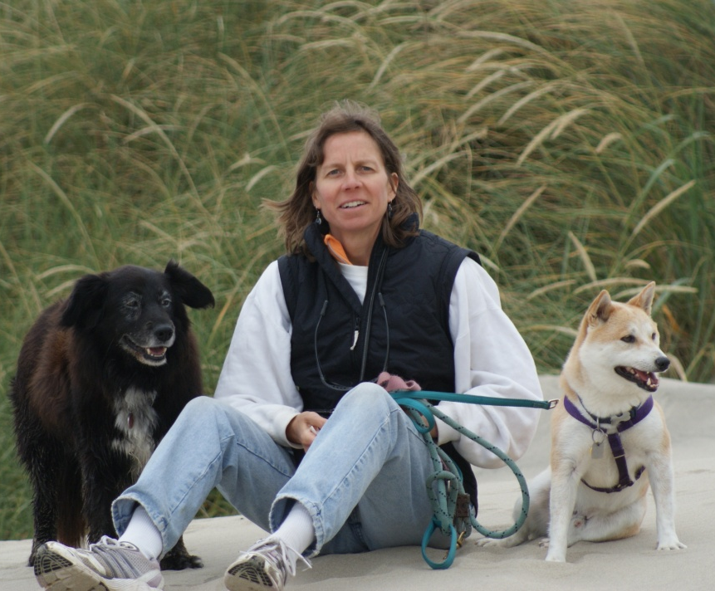

Finding pathways to Relationships
Build intimate partner relationships
Make physical contact; touching is intimate. E.g. a pat on the back, shake hands, kiss and hug the people and pets you love

Slide 24

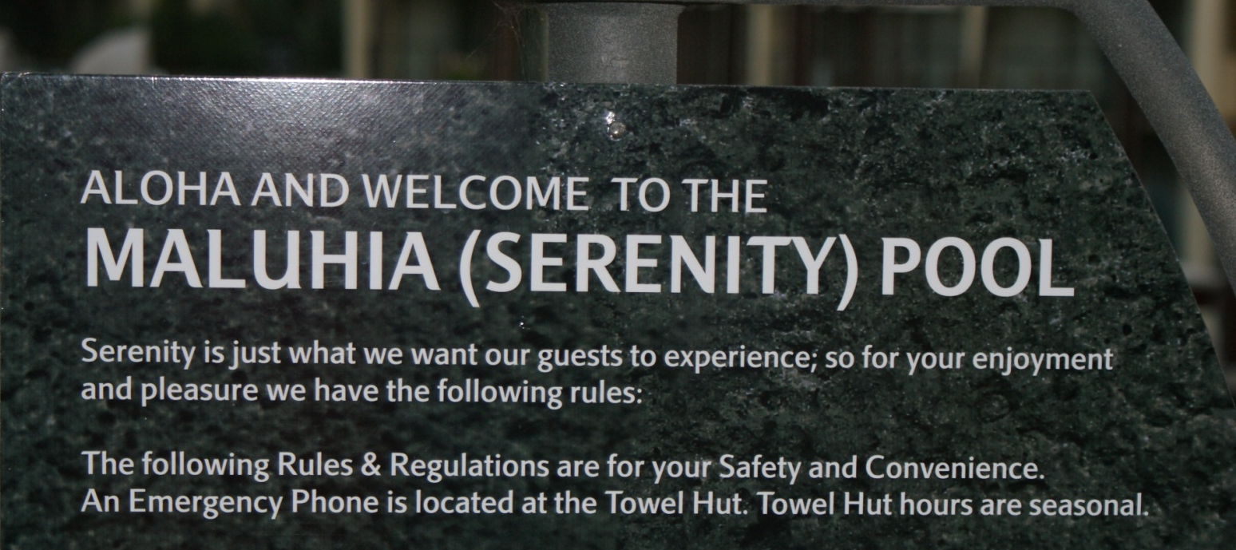
Positivity – What does that mean to you?
A range of positive emotions: appreciation to love, amusement to joy, hope to gratitude… goes beyond self-talk
Doesn’t mean “Grin and bear it” or “Don’t worry, be happy” – Barbara Fredrickson
Heart-felt
It’s fleeting

Slide 25

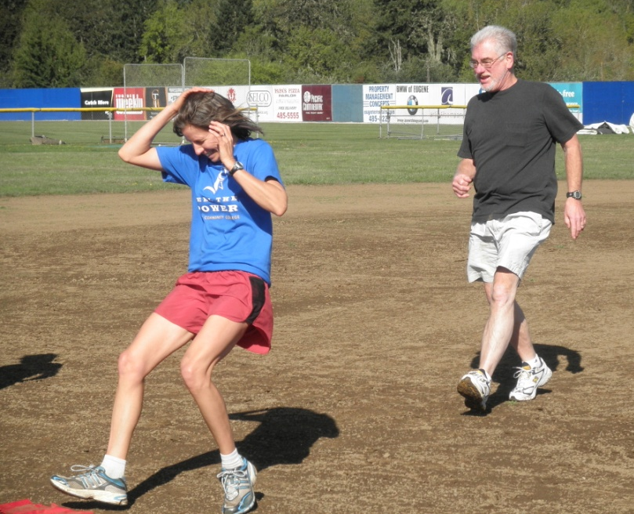
Positivity
“Life gives us negativity. It’s our job to create positivity.” – Barbara Fredrickson
“Every situation has a good side and a bad side; each moment you decide.”
No emotion is banned

Slide 26
The Flourish Hypothesis
Positivity is an active ingredient within human flourishing.
How much positive affect is needed to flourish?
Pos: Neg > or = to 3 to 1
Pos: Neg < 11 : 1
Most Americans are at 2 to 1
Check out http://www.positivityratio.com to check your ratio

Slide 27
Negative vs. positive emotions
Negative emotions narrow options and lead to specific action urges: Anger, Attack, Fear, Escape - Fredrickson (2001)
Positive emotions widen/broaden the array of thoughts and action urges that come to mind: Joy, Play, Create, Push Limits, Contentment, Sit Back & Savor Life Circumstances
E.g. Those who regularly receive recognition and praise at the workplace…

Slide 28
The Undo Hypothesis
If negative emotions narrow and positive emotions broaden….then positive emotions should be efficient antidotes for the lingering aftereffects of negative emotions.
i.e., positive emotions can undo the effects of negative emotions

Slide 29

How can we Increase Positive Emotions in the Workplace?
Gratitude Letters/Visits; to a colleague
Altruistic Acts; specifically in the workplace
Mindfulness/Relaxation Activities during breaks
Discover and Implement Strengths daily at work and leisure
Nurture relationships, with colleagues
Talk about the good stuff, not just problems

Slide 30

Increase your positivity ratio
To change emotional habits, it takes as much as changing any other behavior (e.g. daily exercise, losing weight, adding fruits/vegetables to your diet…)
You can train your mind, eyes and heart to the positivity in your life.
Find Positive meaning
Acts of Kindness
Connect with others
Visualize success

Slide 31
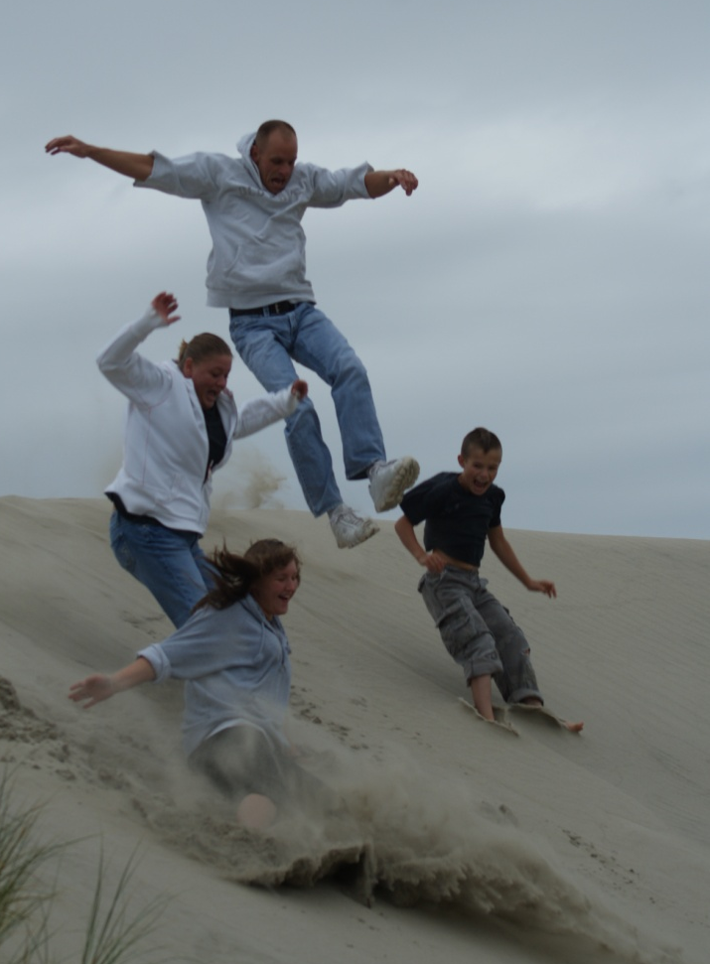
Positivity
You tap into it whenever you feel energized and excited by new ideas. You tap into it whenever you feel at one with your surroundings, at peace. You tap into it whenever you feel playful, creative, or silly.
You tap into it whenever you feel connected to others & loved. In short, you tap into it whenever positive emotions resonate within you.” - Barbara Fredrickson, Positive Psychologist

Slide 32
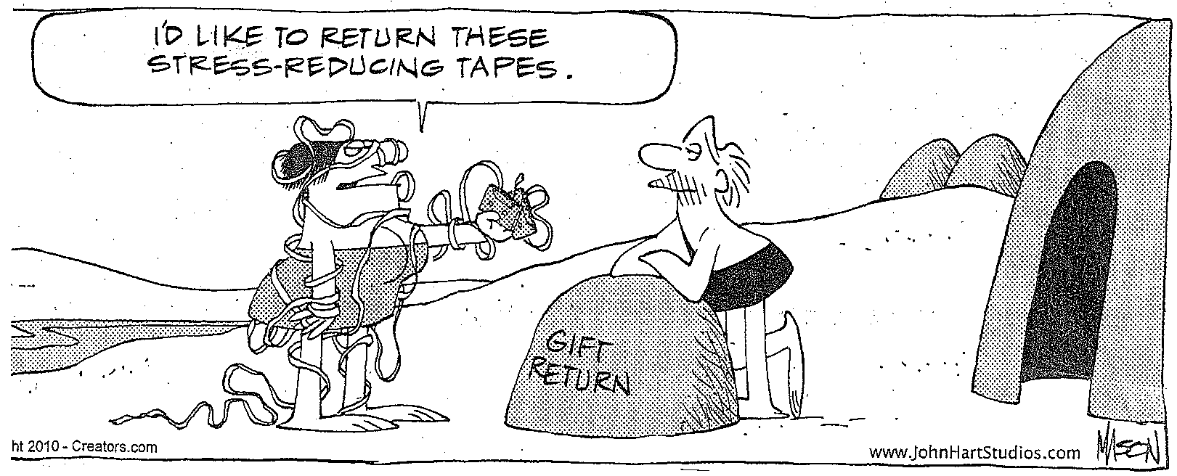
Start gradually, what could you add? What could you take away?

Slide 33
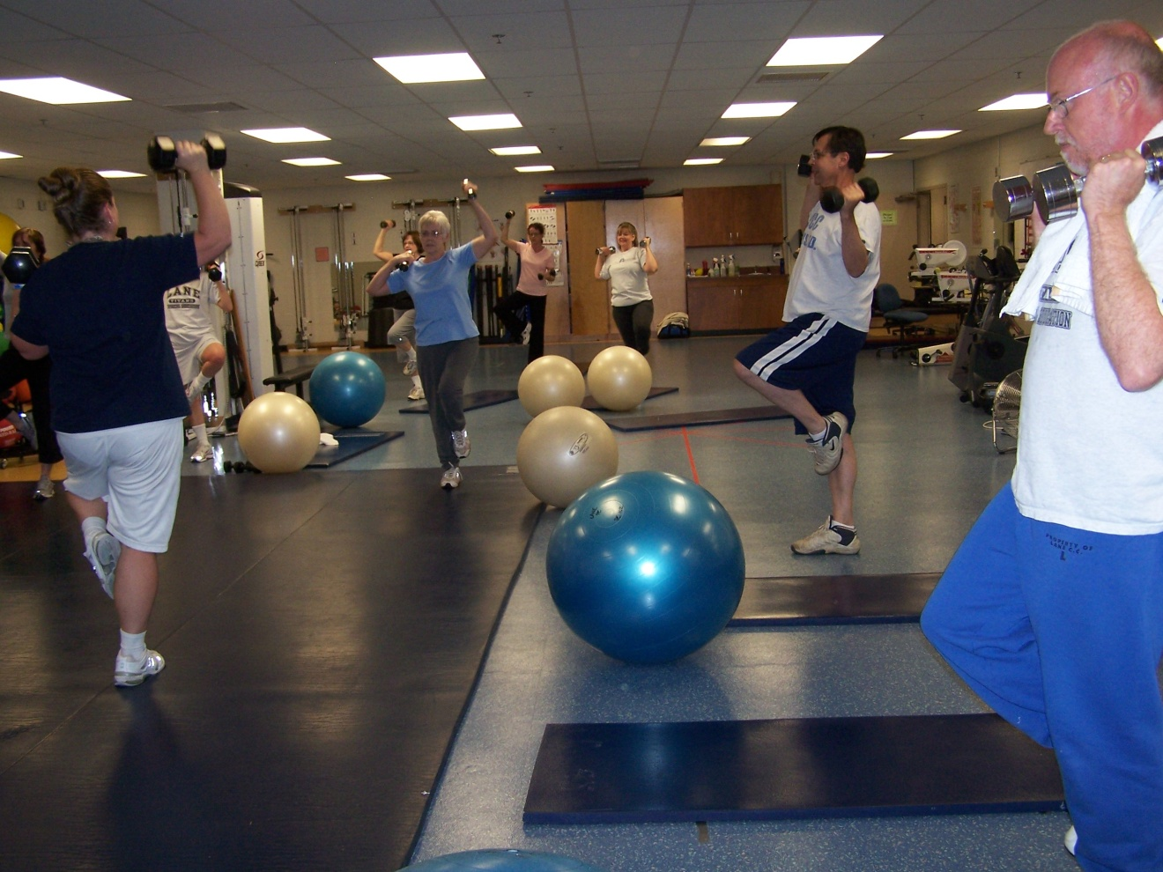
SUMMARY
Encourage healthy behaviors at work (and home); Model wellness; Support policies that promote wellness

Slide 34
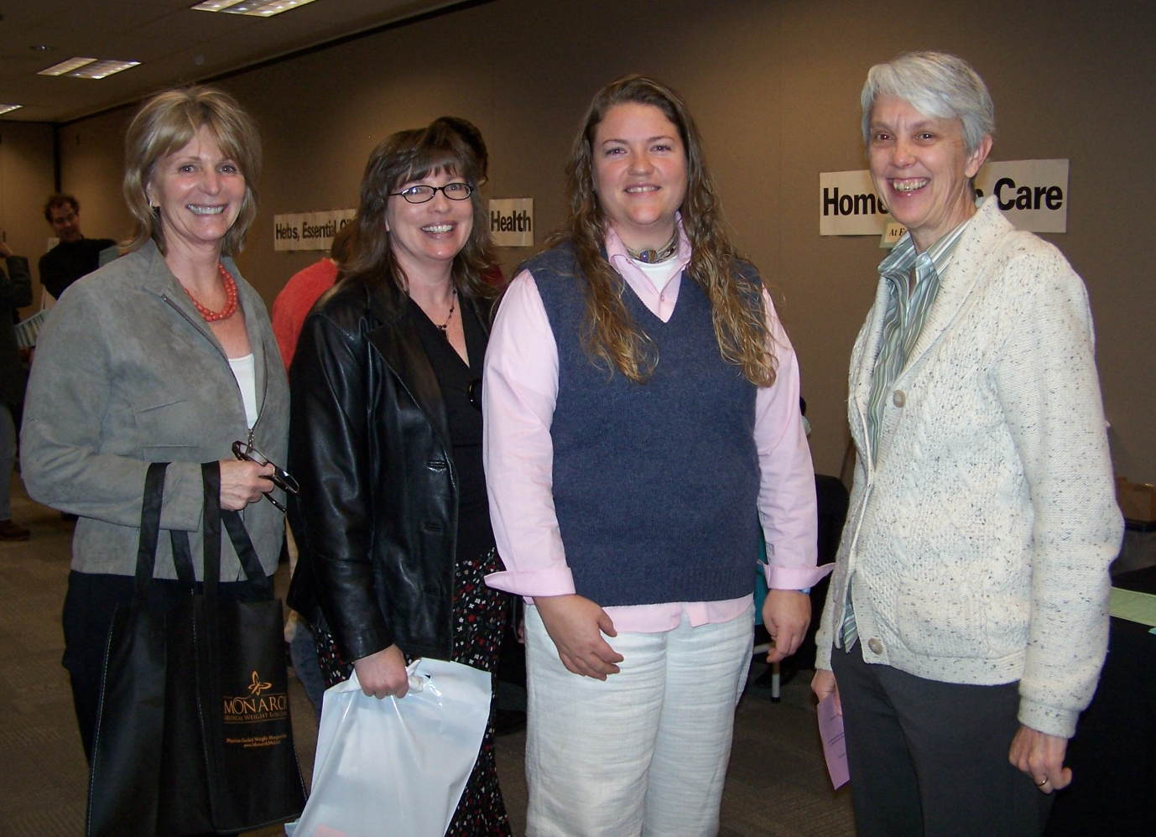
SUMMARY
Relationships: Reach out, make connections, improve relationships: you’ll live longer and better

Slide 35
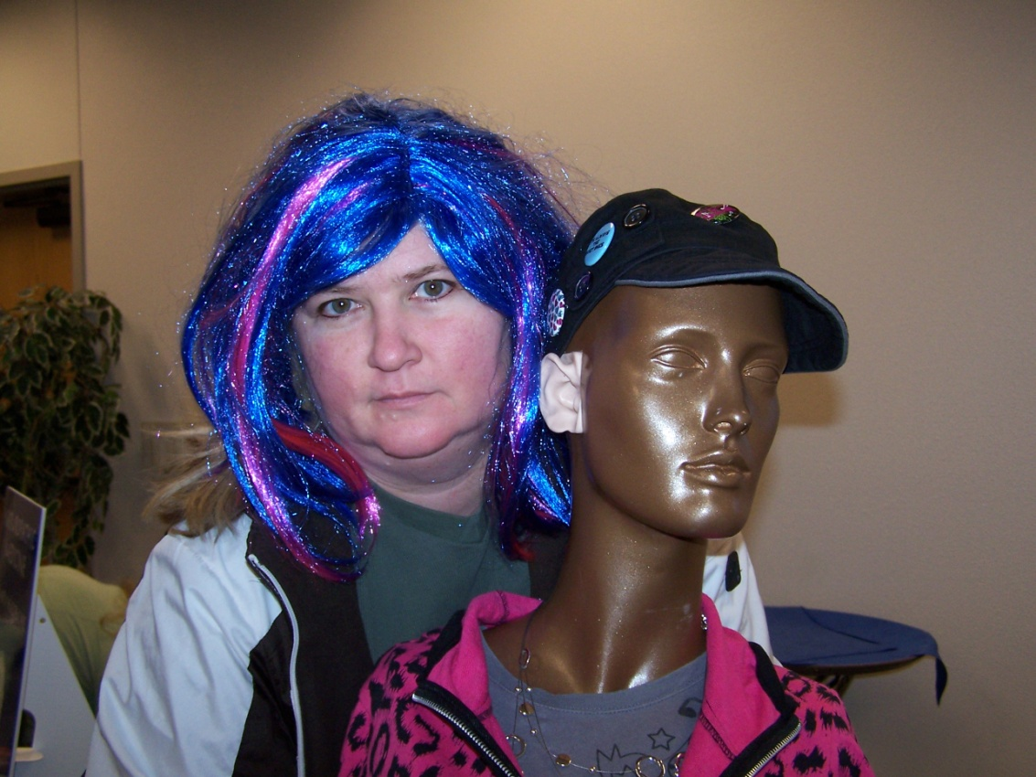
SUMMARY
Increase the positivity in your life: a key to wellness

