Slide 1
Exploring Disciplinary and Subject Area Grounding: What, Exactly, Are Students Integrating?
Kimberly Rosenfeld
George Jarrett
Cerritos College

Slide 2
What We Learned from Washington
Good integrative interdisciplinary assignments proceed from a deep and clearly articulated understanding of the disciplines involved
Assignments should have a clear purpose that (1) addresses a relevant public problem and (2) benefits from disciplinary insights
Interdisciplinary ≠ Integrative

Slide 3
Which Disciplines Are Represented Here Today?
English
Counseling
Art
Philosophy
Psychology
Biology
Speech
Math
Foreign Languages

Slide 4
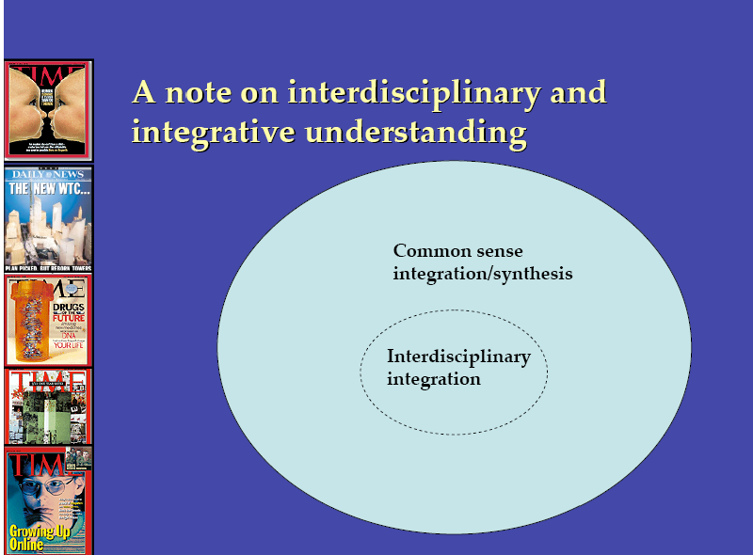

Slide 5
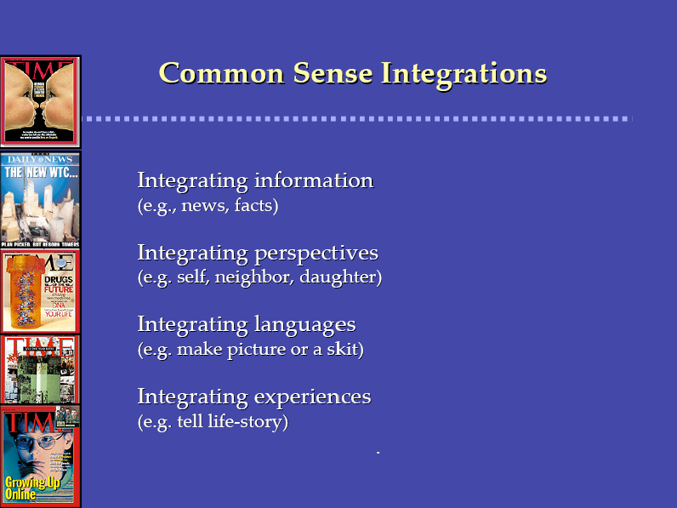

Slide 6
Integrative Interdisciplinary Understanding
Individuals bring insights from different disciplines together to produce new, deeper, broader, more nuanced or effective comprehension of the issue examined.

Slide 7
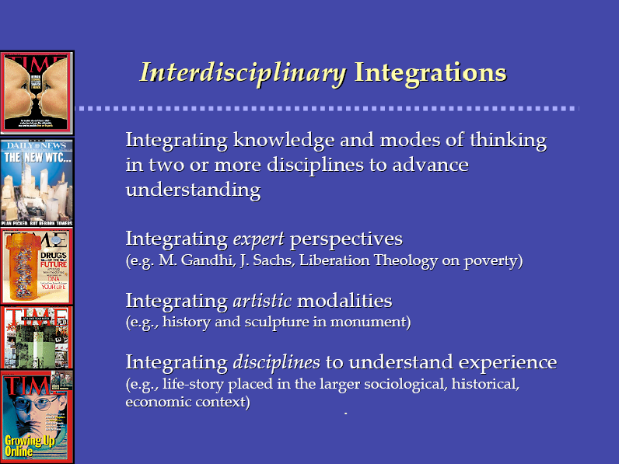

Slide 8
Dimensions of Disciplinary Understanding
Purposes
Methods
Knowledge
Forms
Source: Veronica Boix-Mansilla

Slide 9
Integration
Individuals bring insights from different disciplines together to produce new, deeper, broader, more nuanced or effective comprehension of the issue examined.
Source: Veronica Boix-Mansilla

Slide 10
Purposes of a Discipline
Purposes
Possible uses of this kind of knowledge
What does this kind of inquiry afford?

Slide 11
Purposes of a Discipline
Purposes
Possible uses of this kind of knowledge
What does this kind of inquiry afford?
E.G. History:
  Identify continuity and change over time
  Define and justify the nation

Slide 12
Purposes of a Discipline
Purposes
Possible uses of this kind of knowledge
What does this kind of inquiry afford?
E.G. History:
  Identify continuity and change over time
  Define and justify the nation
Communication:
  Look at and understand messages and perspectives
  Train students to synthesize information, recognize perspectives, and present convincing arguments
  Understand how meaning is generated through communicative acts.
  To actively participate in the democratic process
  To make change happen
  To build relationships.
  To effectively express oneself

Slide 13
Methods Used by a Discipline
Methods
How does one build and validate knowledge in this discipline?

Slide 14
Methods Used by a Discipline
Methods
How does one build and validate knowledge in this discipline?
E.G. History
  Analyze documentary evidence from multiple perspectives
  Construct narratives to explain cause and effect

Slide 15
Methods Used by a Discipline
Methods
How does one build and validate knowledge in this discipline?
E.G. History
  Analyze documentary evidence from multiple perspectives
  Construct narratives to explain cause and effect
Communication
  Qualitative: ethnography, interviews, analyses of texts and recorded speech acts
  Quantitative: questionnaires, surveys
  Generate and validate theories and models of communication.
  Synthesize and utilize numerous social behavioral theories (e.g., psychology, sociology, etc.)

Slide 16
Knowledge Produced by a Discipline
Knowledge
What do we know as a result of the work of this discipline? (concepts; accepted findings; corrected misconceptions…)

Slide 17
Knowledge Produced by a Discipline
Knowledge
What do we know as a result of the work of this discipline? (concepts; accepted findings; corrected misconceptions…)
E.G. History
  Conflict over slavery led to the Civil War
  Paid labor and increased control over reproduction caused women to demand equal rights

Slide 18
Knowledge Produced by a Discipline
Knowledge
What do we know as a result of the work of this discipline? (concepts; accepted findings; corrected misconceptions…)
E.G. History
  Conflict over slavery led to the Civil War
  Paid labor and increased control over reproduction caused women to demand equal rights
Communication
  Everything is symbolic; meaning is separate from the symbol
  Meaning manifests through acts
  Perception plays a role in how we understand and produce messages
  Messages must take into account audience.
  Messages are bound by context and perspective.
  Communication is verbal and non-verbal.

Slide 19
Forms Deployed by a Discipline
Forms
How is the insight of the discipline typically communicated to the world? For the arts, what are the forms and genres of the art?

Slide 20
Forms Deployed by a Discipline
Forms
How is the insight of the discipline typically communicated to the world? For the arts, what are the forms and genres of the art?
E.G. History
  Monographs, journal articles, conference papers
  Archives
  Documentary films
  Museum displays

Slide 21
Forms Deployed by a Discipline
Forms
How is the insight of the discipline typically communicated to the world? For the arts, what are the forms and genres of the art?
E.G. History
  Monographs, journal articles, conference papers
  Archives
  Documentary films
  Museum displays
Communication
  Oral performances (literary interpretation, debate, etc.)
  Consulting, training, coaching, facilitation
  Monographs, journal articles, conference papers

Slide 22
Integration
Individuals bring insights from different disciplines together to produce new, deeper, broader, more nuanced or effective comprehension of the issue examined.
Source: Veronica Boix-Mansilla

